Slide 1
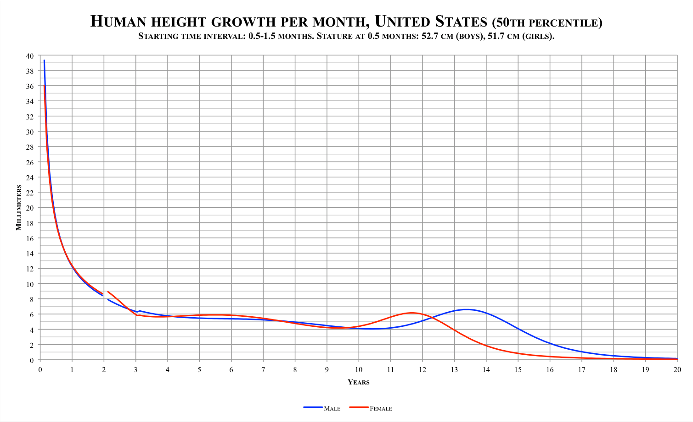
Introduction to Modern Controls
Solution of LTI State-Space Equations
State-Space Solution

Slide 2






1 Introduction
2
Continuous-time state-space solution
3
Discrete-time state-space solution
4
Explicit computation of the state transition matrix e^{At}
5
Explicit Computation of the State Transition Matrix A^{k}
6 Transition Matrix via Inverse Transformation
State-Space Solution

Slide 3
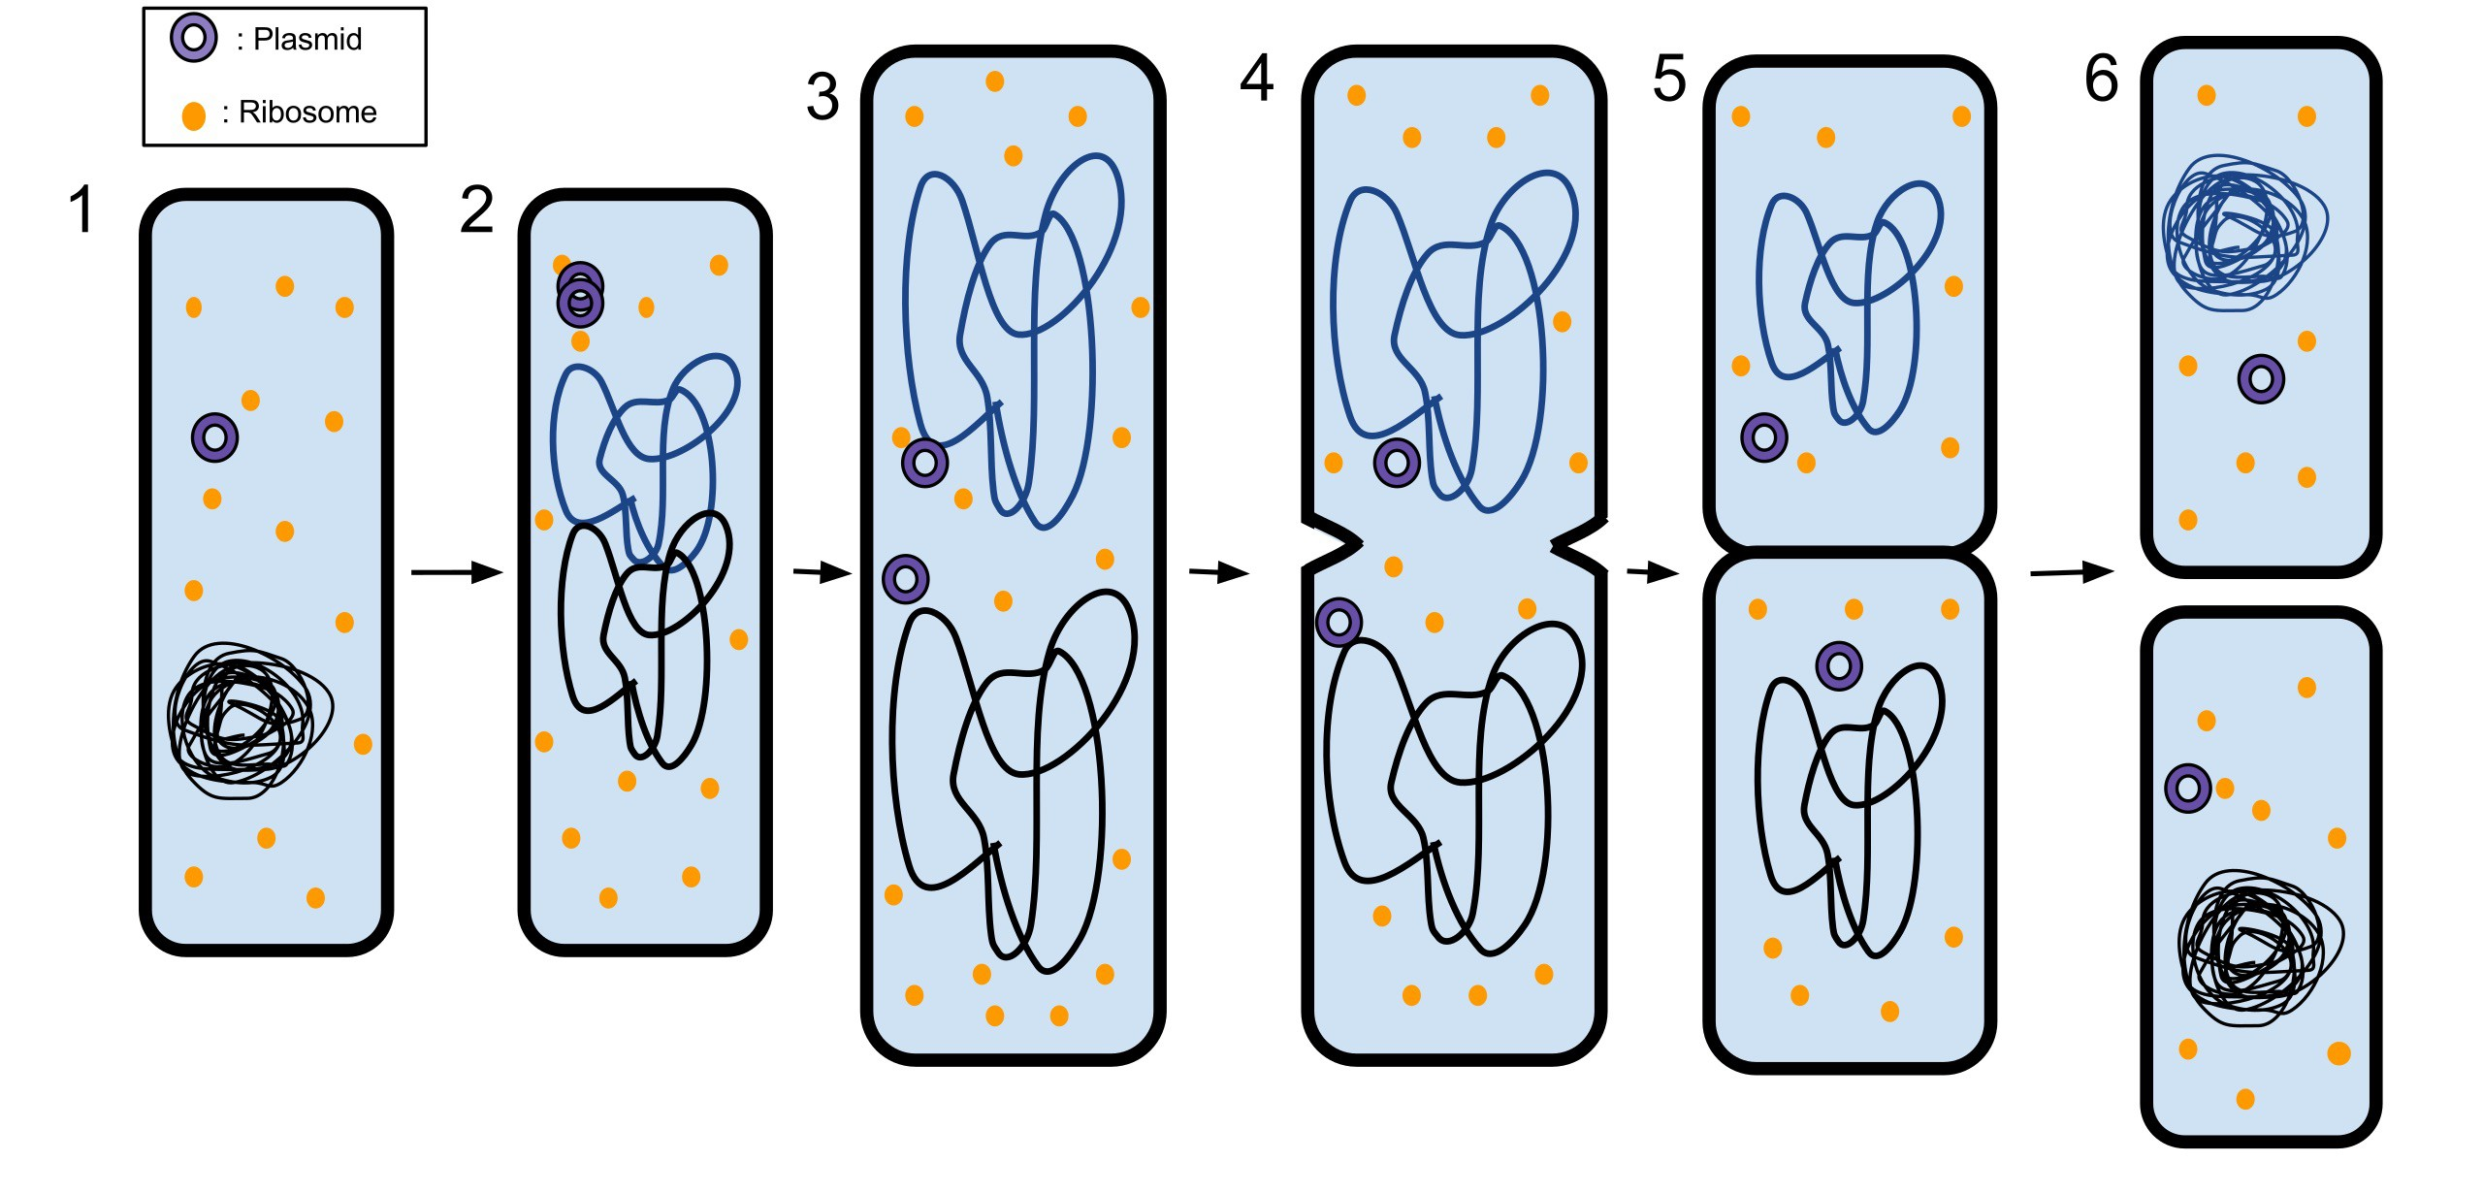

Population dynamics
prokaryotic fission
~1 hour / division with infinite resource
$$100\underset{→}{1hr}200\underset{→}{1hr}400\underset{→}{1hr}800\underset{→}{1hr}⋯$$
State-Space Solution

Slide 4
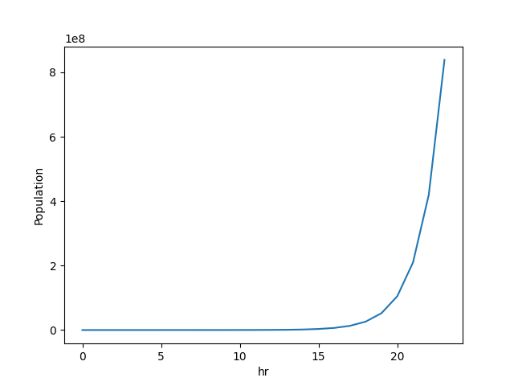
Population dynamics
State-Space Solution

Slide 5
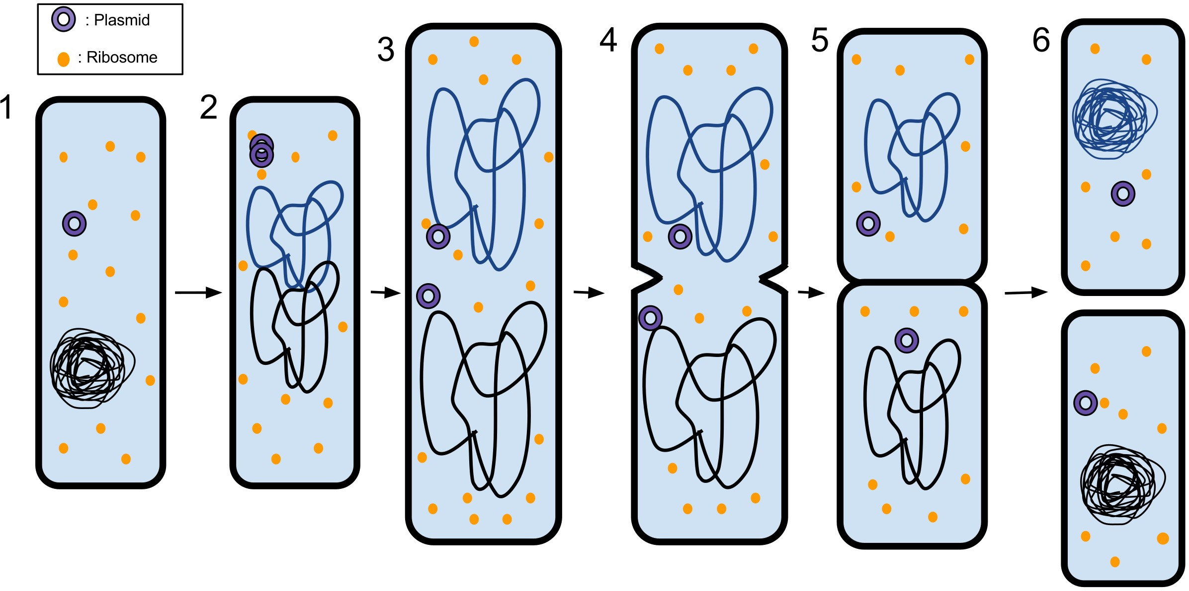


Population dynamics
prokaryotic fission
~1 hour / division with infinite resource
after 1 day:
$$100\underset{→}{1hr}200\underset{→}{1hr}400\underset{→}{1hr}800\underset{→}{1hr}⋯$$
$$100\overset{1hr}{\overset{→}{\frac{ΔN}{N}=1}}200\underset{→}{1hr}400\underset{→}{1hr}⋯→100×2^{24}=1.7B!$$
State-Space Solution

Slide 6
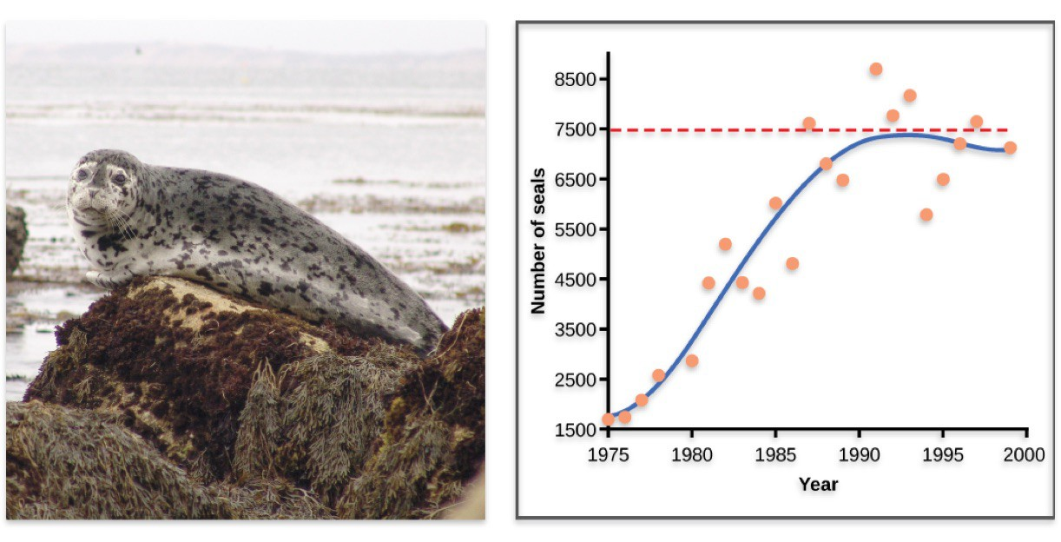
Population dynamics
Environmental limits to population growth: Figure 1, by OpenStax College, Biology, CC BY 4.0.
State-Space Solution

Slide 7
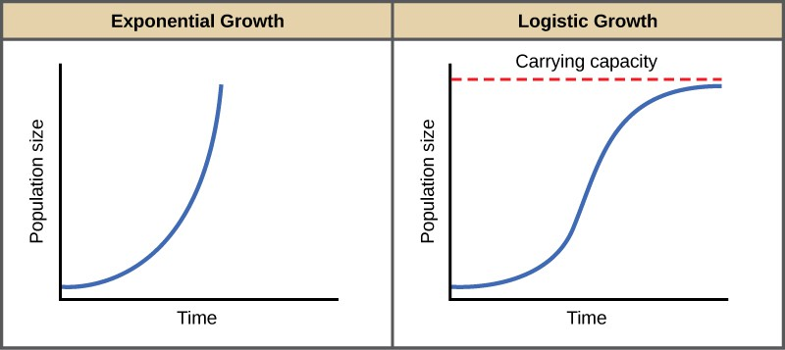

The exponential function and population dynamics
more general population dynamics (w/ infinite resources)
$\frac{dN}{dt}=\overset{r}{\overbrace{\left(\text{birth} \text{rate}−\text{death} \text{rate}\right)}}N⇒N\left(t\right)=e^{rt}N\left(0\right)$
logistic growth (w/ limited resources in reality)
$\frac{dN}{dt}=r\frac{K−N}{K}N⇒N\left(t\right)=\frac{KN_{0}e^{rt}}{\left(K−N_{0}\right)+N_{0}e^{rt}}=\frac{K}{1+\frac{K−N_{0}}{N_{0}}e^{−rt}}$
State-Space Solution

Slide 8
The exponential function and the logistic S curve: example
20000
17500
15000
12500
10000
7500
5000
2500
0
20000/(1 + (20000 100)e ^{0.5t}/100)
_{e}0.5t
15 20 25 30
t
0
5
10
State-Space Solution

Slide 9
The logistic S curve
K
₁₊ ^{K−N}0 _{e}−rt
N₀
can also be written as
10000
r=0.5 r=1.0 r=2.0 r=4.0
K
1+e
−r(t−to)
K: final value
r: logistic growth rate
t_{o}: midpoint
8000
6000
4000
2000
0
5.0 2.5
0.0 2.5 5.0 7.5 10.0 12.5 15.0
t
State-Space Solution

Slide 10
The logistic S curve
K
₁₊ ^{K−N}0 _{e}−rt
N₀
can also be written as
¹⁰⁰⁰⁰ t0=2 t0=4 t0=6
8000 ^{t}0⁼⁸
6000
4000
2000
0
K
1+e
−r(t−to)
K: final value
r: logistic growth rate
t_{o}: midpoint
5.0 2.5
0.0 2.5 5.0 7.5 10.0 12.5 15.0
t
State-Space Solution

Slide 11
The logistic S curve
K
₁₊ ^{K−N}0 _{e}−rt
N₀
can also be written as
14000
K=8000 K=10000 K=12000
K
_{1+e}−r(t−to)
K: final value
r: logistic growth rate
t_{o}: midpoint
12000
K=14000
10000
8000
6000
4000
2000
0
5.0 2.5 0.0 2.5 5.0 7.5 10.0 12.5 15.0
t
State-Space Solution

Slide 12
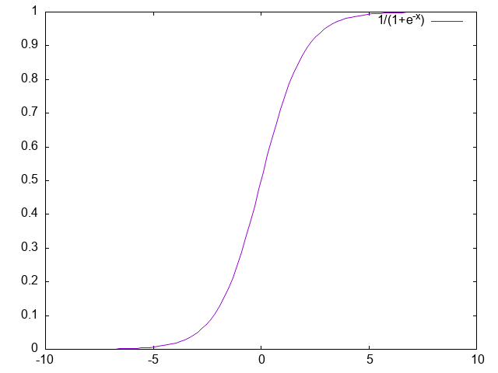
The logistic function in deep learning
1
1 + e^{−x}
σ (x) =
transforms the input variables into a probability value between 0 and 1 represents the likelihood of the dependent variable being 1 or 0
State-Space Solution

Slide 13


1 Introduction
2
Continuous-time state-space solution
3
Discrete-time state-space solution
4
Explicit computation of the state transition matrix e^{At}
5
Explicit Computation of the State Transition Matrix A^{k}
6 Transition Matrix via Inverse Transformation
State-Space Solution

Slide 14

General LTI continuous-time state equation
$$\frac{dx}{dt}=Ax+Bu$$
$$Σ=\left[\begin{matrix}A_{n×n} & B_{n×m} \\ C_{n_{y}×n} & D_{n_{y}×m}\end{matrix}\right]$$
to solve the vector equation $\dot{x}=Ax+Bu$, we start with the scalar case when $x,a,b,u∈ℝ$.
State-Space Solution

Slide 15

The solution to x˙ = ax + bu
fundamental property of exponential functions
$\frac{d}{dt}e^{at}=ae^{at}, \frac{d}{dt}e^{−at}=−ae^{−at}$
$\dot{x}\left(t\right)=ax\left(t\right)+bu\left(t\right), a≠0\overset{∵e^{−at}≠0}{⇒}e^{−at}\dot{x}\left(t\right)−e^{−at}ax\left(t\right)=e^{−at}bu\left(t\right)$
namely,
$$\begin{matrix}\frac{d}{dt}\left\{e^{−at}x\left(t\right)\right\} & =e^{−at}bu\left(t\right)⇔d\left\{e^{−at}x\left(t\right)\right\}=e^{−at}bu\left(t\right)dt \\ ⇒ & \boxed{e^{−at}x\left(t\right)=e^{−at_{0}}x\left(t_{0}\right)+\int_{t_{0}}^{t}{e^{−aτ}}bu\left(τ\right)dτ}\end{matrix}$$
State-Space Solution

Slide 16

The solution to x˙ = ax + bu
$$e^{−at}x\left(t\right)=e^{−at_{0}}x\left(t_{0}\right)+\int_{t_{0}}^{t}{e^{−aτ}}bu\left(τ\right)dτ$$
when $t_{0}=0$, we have
$$\boxed{x\left(t\right)=\underset{\text{free} \text{response}}{\underset{⏟}{e^{at}x\left(0\right)}}+\underset{\text{forced} \text{response}}{\underset{⏟}{\int_{0}^{t}{e^{a\left(t−τ\right)}}bu\left(τ\right)dτ}}}$$
State-Space Solution

Slide 17

About e
$$e=\sum_{n=0}^{∞}{\frac{1}{n!}}=2.71828…$$
Taylor expansion
$$e^{x}=1+\frac{x}{1!}+\frac{1}{2!}{\left(x\right)}^{2}+…+\frac{1}{n!}{\left(x\right)}^{n}+…$$
letting $x=1$ gives $e=\sum_{n=0}^{∞}{\frac{1}{n!}}$
Python demonstration:
import math math.e
for ii in range(10):
print(sum(1/math.factorial(k) for k in range(ii)))
State-Space Solution

Slide 18
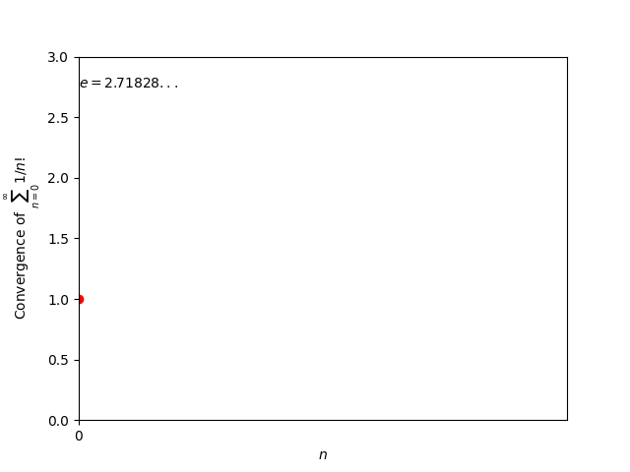

About e
$$e=\sum_{n=0}^{∞}{\frac{1}{n!}}=2.71828…$$
State-Space Solution

Slide 19
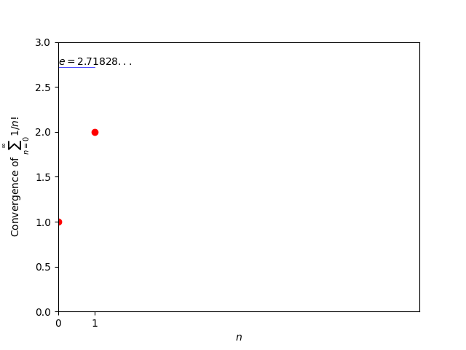
About e
$$e=\sum_{n=0}^{∞}{\frac{1}{n!}}=2.71828…$$
State-Space Solution

Slide 20
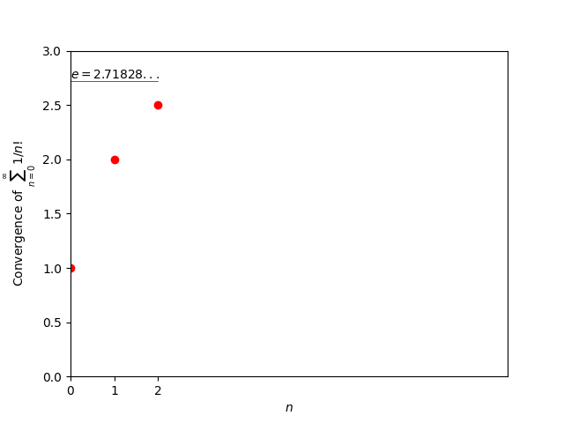
About e
$$e=\sum_{n=0}^{∞}{\frac{1}{n!}}=2.71828…$$
State-Space Solution

Slide 21
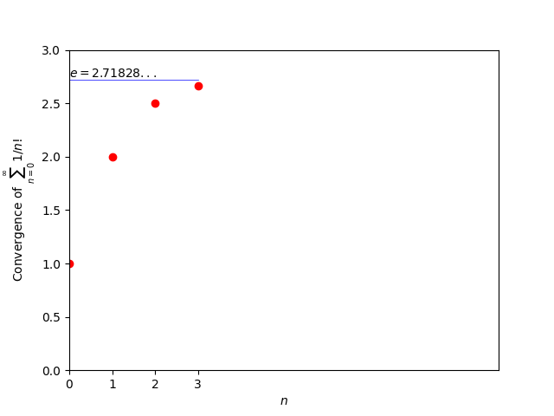
About e
$$e=\sum_{n=0}^{∞}{\frac{1}{n!}}=2.71828…$$
State-Space Solution

Slide 22
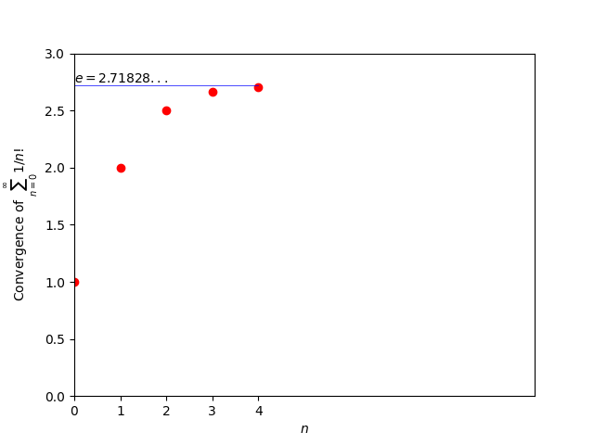
About e
$$e=\sum_{n=0}^{∞}{\frac{1}{n!}}=2.71828…$$
State-Space Solution

Slide 23
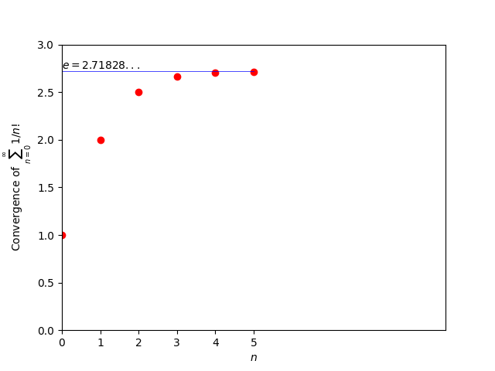
About e
$$e=\sum_{n=0}^{∞}{\frac{1}{n!}}=2.71828…$$
State-Space Solution

Slide 24
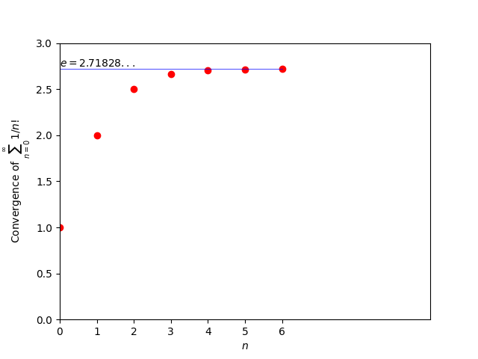
About e
$$e=\sum_{n=0}^{∞}{\frac{1}{n!}}=2.71828…$$
State-Space Solution

Slide 25
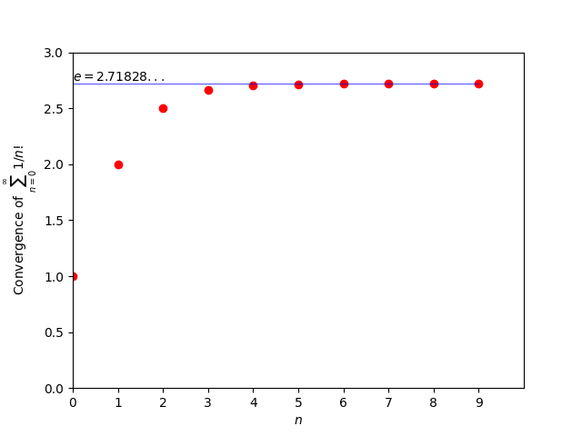
About e
$$e=\sum_{n=0}^{∞}{\frac{1}{n!}}=2.71828…$$
State-Space Solution

Slide 26
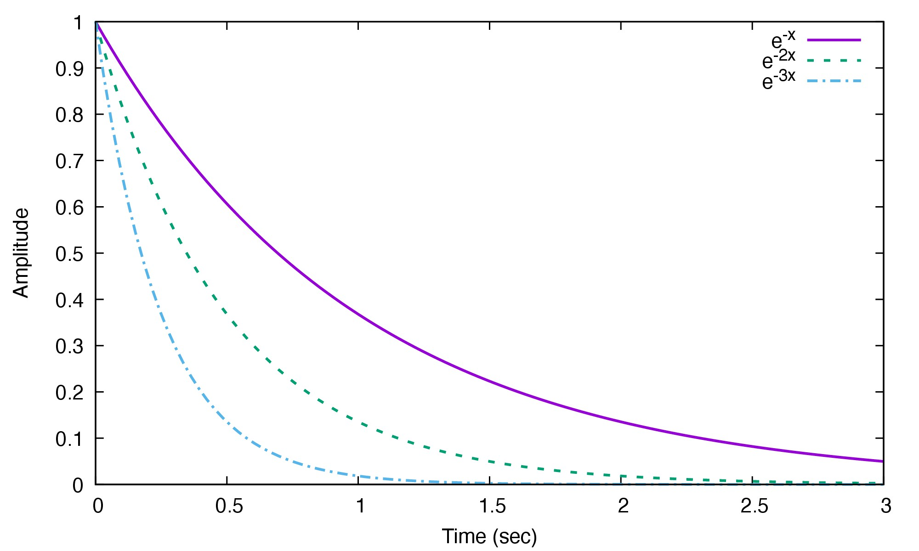
The solution to x˙ = ax + bu
Solution concepts of e^{at}x (0)
e = 2.71828 . . .
e⁻¹ ≈ 37%,
e⁻² ≈ 14%,
e⁻³ ≈ 5%,
e⁻⁴ ≈ 2%
time constant τ ≜ ¹ when
|a|
a < 0: after 3τ , e^{at}x (0), the transient has approximately converged
State-Space Solution

Slide 27
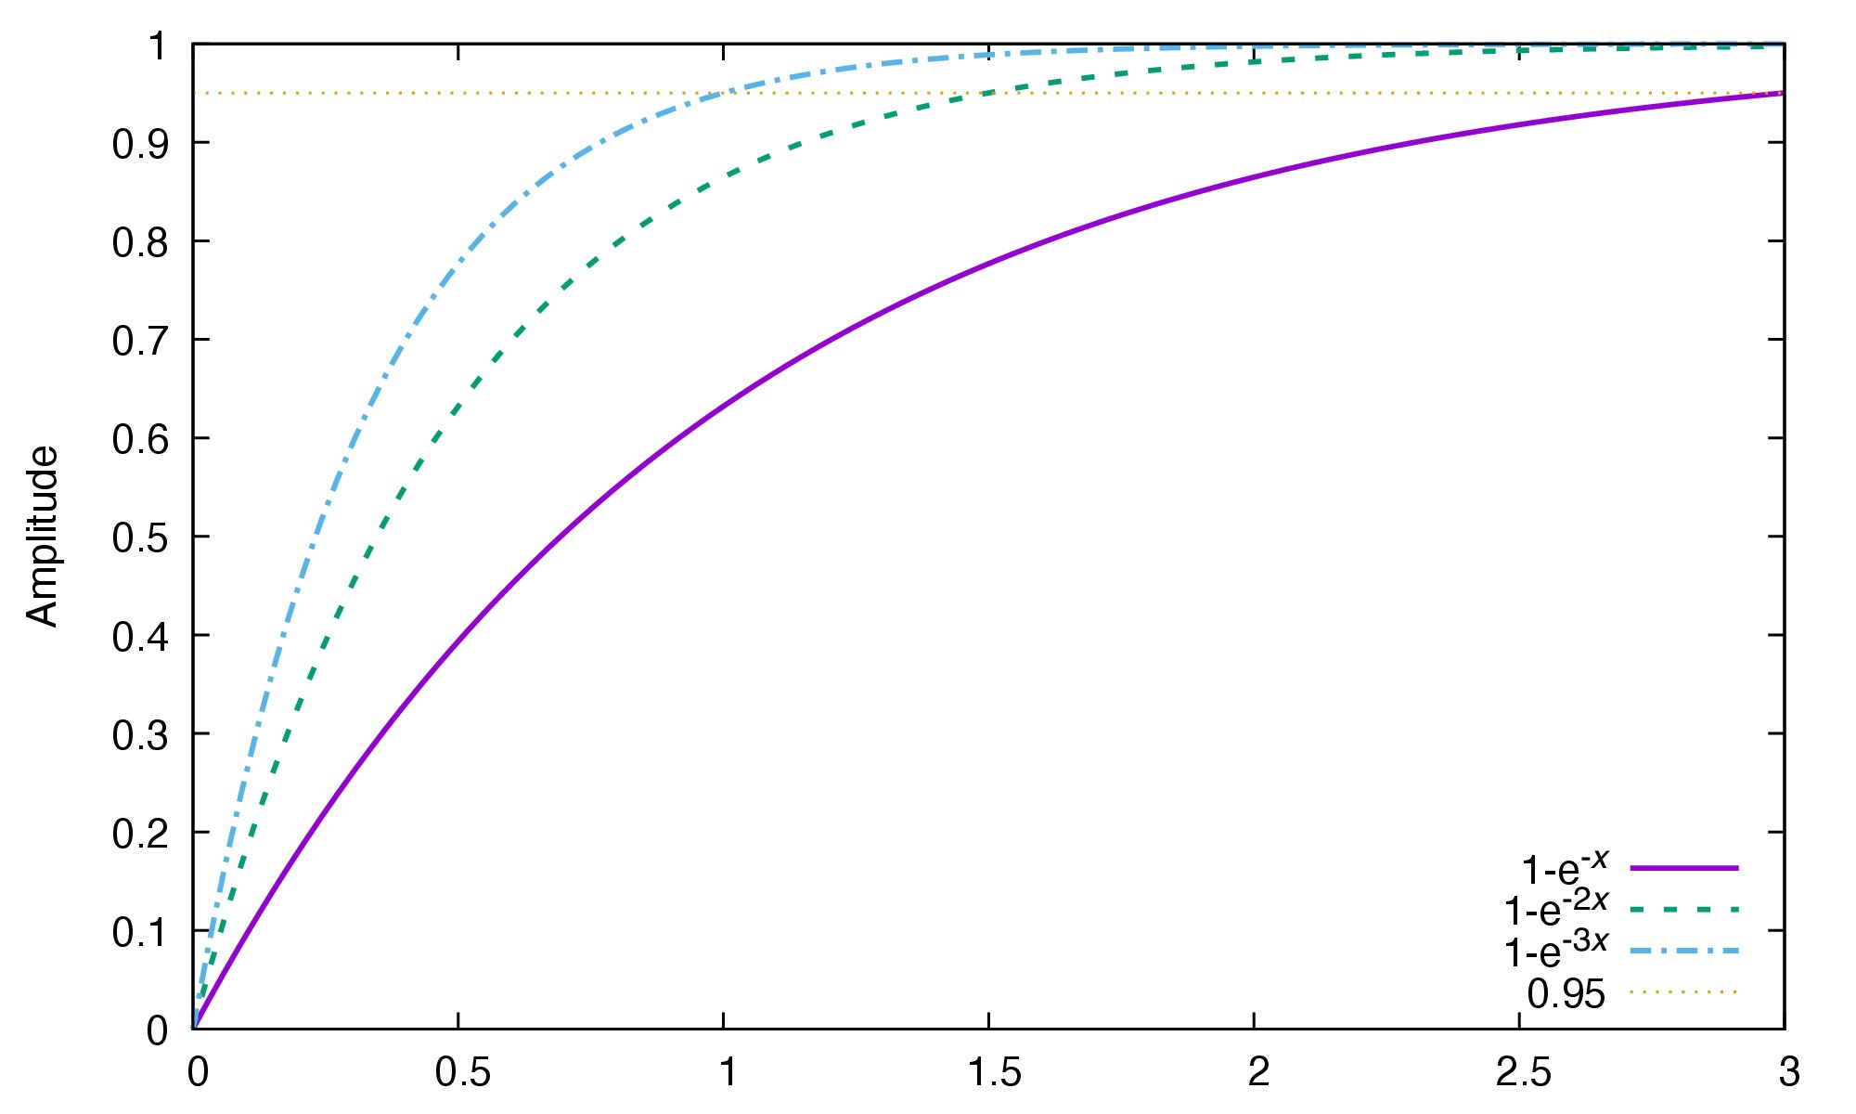

The solution to x˙ = ax + bu
Unit step response
when a < 0 and u(t) = 1(t) (the step function), the solution is
$$x\left(t\right)=\frac{b}{\left|a\right|}\left(1−e^{at}\right)$$
State-Space Solution

Slide 28



The solution to n^{th}-order LTI systems
general state-space equation
$$Σ: \left\{\begin{matrix}\dot{x}\left(t\right) & =Ax\left(t\right)+Bu\left(t\right) \\ y\left(t\right) & =Cx\left(t\right)+Du\left(t\right)\end{matrix}\right. x\left(t_{0}\right)=x_{0}∈ℝ^{n}, A∈ℝ^{n×n}$$
solution
$$\boxed{x\left(t\right)=\underset{\text{free} \text{response}}{\underset{⏟}{e^{A\left(t−t_{0}\right)}x_{0}}}+\underset{\text{forced} \text{response}}{\underset{⏟}{\int_{t_{0}}^{t}{e^{A\left(t−τ\right)}}Bu\left(τ\right)dτ}}}$$
$$y\left(t\right)=Ce^{A\left(t−t_{0}\right)}x_{0}+C\int_{t_{0}}^{t}{e^{A\left(t−τ\right)}}Bu\left(τ\right)dτ+Du\left(t\right)$$
in both the free and the forced responses, computing e^{At} is key
e^{A(t−t0)}: called the transition matrix
State-Space Solution

Slide 29

The state transition matrix e^{At}
scalar case with a ∈ R: Taylor expansion gives
$$e^{at}=1+at+\frac{1}{2}{\left(at\right)}^{2}+⋯+\frac{1}{n!}{\left(at\right)}^{n}+⋯$$
the transition scalar Φ(t, t₀) = e^{a(t−t0)} satisfies
Φ(t, t) = 1
Φ(t₃, t₂)Φ(t₂, t₁) = Φ(t₃, t₁) Φ(t₂, t₁) = Φ⁻¹(t₁, t₂)
(transition to itself) (consecutive transition) (reverse transition)
State-Space Solution

Slide 30


The state transition matrix e^{At}
matrix case with A ∈ R^{n×n}:
$$e^{At}=I_{n}+At+\frac{1}{2}A^{2}t^{2}+⋯+\frac{1}{n!}A^{n}t^{n}+⋯$$
as I_{n} and A^{i} are matrices of dimension n × n, e^{At} must ∈ R^{n×n}
the transition matrix Φ(t, t₀) = e^{A(t−t0)} satisfies
Φ(t, t) = I_{n}
Φ(t₃, t₂)Φ(t₂, t₁) = Φ(t₃, t₁)
Φ(t₂, t₁) = Φ⁻¹(t₁, t₂)
$${e^{A0}=I_{n} \atop \begin{aligned}e^{At_{1}}e^{At_{2}}=e^{A\left(t_{1}+t_{2}\right)} \\ e^{−At}={\left[e^{At}\right]}^{−1}\end{aligned}}\begin{matrix} & \\ & \\ & \end{matrix}$$
note, however, that e^{At}e^{Bt} = e^{(A+B)t} if and only if AB = BA (check by using Taylor expansion)
State-Space Solution

Slide 31



Computing e^{At} when A is diagonal or in Jordan form
convenient when A is a diagonal or Jordan matrix
the case with a diagonal matrix $A=\left[\begin{matrix}λ_{1} & 0 & 0 \\ 0 & λ_{2} & 0 \\ 0 & 0 & λ_{3}\end{matrix}\right]$:
$A^{2}=\left[\begin{matrix}λ_{1}^{2} & 0 & 0 \\ 0 & λ_{2}^{2} & 0 \\ 0 & 0 & λ_{3}^{2}\end{matrix}\right]$, $…$, $A^{n}=\left[\begin{matrix}λ_{1}^{n} & 0 & 0 \\ 0 & λ_{2}^{n} & 0 \\ 0 & 0 & λ_{3}^{n}\end{matrix}\right]$
all matrices on the right side of
$$e^{At}=I+At+\frac{1}{2}A^{2}t^{2}+⋯+\frac{1}{n!}A^{n}t^{n}+⋯$$
are easy to compute
State-Space Solution

Slide 32

Computing a structured e^{At} via Taylor expansion
convenient when $A$ is a diagonal or Jordan matrix
the case with a diagonal matrix $A=\left[\begin{matrix}λ_{1} & 0 & 0 \\ 0 & λ_{2} & 0 \\ 0 & 0 & λ_{3}\end{matrix}\right]$:
$$\begin{matrix}e^{At} & =I+At+\frac{1}{2}A^{2}t​^{2}+…+\frac{1}{n!}A^{n}t​^{n}+… \\ & =\left[\begin{matrix}1 & 0 & 0 \\ 0 & 1 & 0 \\ 0 & 0 & 1\end{matrix}\right]+\left[\begin{matrix}λ_{1}t & 0 & 0 \\ 0 & λ_{2}t & 0 \\ 0 & 0 & λ_{3}t\end{matrix}\right]+\left[\begin{matrix}\frac{1}{2}λ_{1}^{2}t^{2} & 0 & 0 \\ 0 & \frac{1}{2}λ_{2}^{2}t^{2} & 0 \\ 0 & 0 & \frac{1}{2}λ_{3}^{2}t^{2}\end{matrix}\right]+… \\ & =\left[\begin{matrix}1+λ_{1}t+\frac{1}{2}λ_{1}^{2}t^{2}+… & 0 & 0 \\ 0 & 1+λ_{2}t+\frac{1}{2}λ_{2}^{2}t^{2}+… & 0 \\ 0 & 0 & 1+λ_{3}t+\frac{1}{2}λ_{3}^{2}t^{2}+…\end{matrix}\right] \\ & \underline{=\left[\begin{matrix}e^{λ_{1}t} & 0 & 0 \\ 0 & e^{λ_{2}t} & 0 \\ 0 & 0 & e^{λ_{3}t}\end{matrix}\right]}\end{matrix}$$
State-Space Solution

Slide 33

Computing a structured e^{At} via Taylor expansion
the case with a Jordan matrix $A=\left[\begin{matrix}λ & 1 & 0 \\ 0 & λ & 1 \\ 0 & 0 & λ\end{matrix}\right]$:
decompose $A=$ $\underset{λI_{3}}{\underbrace{\left[\begin{matrix}λ & 0 & 0 \\ 0 & λ & 0 \\ 0 & 0 & λ\end{matrix}\right]}}+\underset{N}{\underbrace{\left[\begin{matrix}0 & 1 & 0 \\ 0 & 0 & 1 \\ 0 & 0 & 0\end{matrix}\right]}}⟹e^{At}=e^{\left(λI_{3}t+Nt\right)}$
also, $\left(λI_{3}t\right)\left(Nt\right)=λNt^{2}=\left(Nt\right)\left(λI_{3}t\right)$ and hence $e^{\left(λI_{3}t+Nt\right)}=e^{λIt}e^{Nt}$
thus
$$e^{At}=e^{\left(λI_{3}t+Nt\right)}=e^{λIt}e^{Nt}=\underline{e^{λt}e^{Nt}}$$
$∵e^{λIt}=e^{λt}I$
State-Space Solution

Slide 34

Computing a structured e^{At} via Taylor expansion
$$\underset{λI_{3}}{\underbrace{\left[\begin{matrix}λ & 0 & 0 \\ 0 & λ & 0 \\ 0 & 0 & λ\end{matrix}\right]}}+\underset{N}{\underbrace{\left[\begin{matrix}0 & 1 & 0 \\ 0 & 0 & 1 \\ 0 & 0 & 0\end{matrix}\right]}}, e^{At}=e^{λt}e^{Nt}$$
$N$ is nilpotent¹: $N^{3}=N^{4}=⋯=0I_{3}$, yielding
$$e^{Nt}=I_{3}+Nt+\frac{1}{2}N^{2}t^{2}+\frac{1}{3!}N^{3}t^{3}+⋯ =\left[\begin{matrix}1 & t & \frac{t^{2}}{2} \\ 0 & 1 & t \\ 0 & 0 & 1\end{matrix}\right]$$
thus
$$e^{At}=\left[\begin{matrix}e^{λt} & te^{λt} & \frac{t^{2}}{2}e^{λt} \\ 0 & e^{λt} & te^{λt} \\ 0 & 0 & e^{λt}\end{matrix}\right]$$
$$0$$
$$0$$
¹“nil” ∼ zero; “potent” ∼ taking powers.
State-Space Solution

Slide 35

Computing a structured e^{At} via Taylor expansion
Mass moving on a straight line with zero friction and no external force
$$\frac{d}{dt}\left[\begin{matrix}x_{1} \\ x_{2}\end{matrix}\right]=\underset{A}{\underset{⏟}{\left[\begin{matrix}0 & 1 \\ 0 & 0\end{matrix}\right]}}\left[\begin{matrix}x_{1} \\ x_{2}\end{matrix}\right]$$
$x\left(t\right)=e^{At}x\left(0\right)$ where
$$e^{At}=I+\left[\begin{matrix}0 & 1 \\ 0 & 0\end{matrix}\right]t+\frac{1}{2!}\underset{=\left[\begin{matrix}0 & 0 \\ 0 & 0\end{matrix}\right]}{\underset{⏟}{\left[\begin{matrix}0 & 1 \\ 0 & 0\end{matrix}\right]\left[\begin{matrix}0 & 1 \\ 0 & 0\end{matrix}\right]}}t^{2}+…\underline{=\left[\begin{matrix}1 & t \\ 0 & 1\end{matrix}\right]}.$$
State-Space Solution

Slide 36

Computing low-order e^{At} via column solutions
an intuition of the matrix entries in $e^{At}$: consider:
$$\dot{x}=Ax=\left[\begin{matrix}0 & 1 \\ 0 & −1\end{matrix}\right]x, x\left(0\right)=x_{0}$$
$$\begin{matrix}x\left(t\right) & =e^{At}x\left(0\right)=\left[\begin{matrix}\text{1}\text{st} \text{column} & \text{2}\text{nd} \text{column} \\ \overbrace{a_{1}\left(t\right)} & \overbrace{a_{2}\left(t\right)}\end{matrix}\right]\left[\begin{matrix}x_{1}\left(0\right) \\ x_{2}\left(0\right)\end{matrix}\right] \\ & =a_{1}\left(t\right)x_{1}\left(0\right)+a_{2}\left(t\right)x_{2}\left(0\right)\end{matrix}$$
observation
$$\begin{matrix}x\left(0\right)=\left[\begin{matrix}1 \\ 0\end{matrix}\right] & ⇒x\left(t\right)=a_{1}\left(t\right) \\ x\left(0\right)=\left[\begin{matrix}0 \\ 1\end{matrix}\right] & ⇒x\left(t\right)=a_{2}\left(t\right)\end{matrix}$$
State-Space Solution

Slide 37

Computing low-order e^{At} via column solutions
$$\dot{x}=Ax=\left[\begin{matrix}0 & 1 \\ 0 & −1\end{matrix}\right]x, x\left(0\right)=x_{0}$$
hence, we can obtain $e^{At}$ from:
write out $\begin{matrix}{\dot{x}}_{1}\left(t\right)= & x_{2}\left(t\right) \\ {\dot{x}}_{2}\left(t\right)= & −x_{2}\left(t\right)\end{matrix}⇒\begin{matrix}x_{1}\left(t\right)= & e^{0t}x_{1}\left(0\right)+\int_{0}^{t}{e^{0\left(t−τ\right)}}x_{2}\left(τ\right)dτ \\ x_{2}\left(t\right)= & e^{−t}x_{2}\left(0\right)\end{matrix}$
let $x\left(0\right)=\left[\begin{matrix}1 \\ 0\end{matrix}\right]$, then $\begin{matrix}x_{1}\left(t\right)≡1 \\ x_{2}\left(t\right)≡0\end{matrix}$, namely $x\left(t\right)=\left[\begin{matrix}1 \\ 0\end{matrix}\right]$
let $x\left(0\right)=\left[\begin{matrix}0 \\ 1\end{matrix}\right]$, then $x_{2}\left(t\right)=e^{−t}$ and $x_{1}\left(t\right)=1−e^{−t}$, or more compactly, $x\left(t\right)=\left[\begin{matrix}1−e^{−t} \\ e^{−t}\end{matrix}\right]$
write out directly $\underline{e^{At}=\left[\begin{matrix}1 & 1−e^{−t} \\ 0 & e^{−t}\end{matrix}\right]}$
State-Space Solution

Slide 38

Computing low-order e^{At} via column solutions
Compute e^{At} where
$$A=\left[\begin{matrix}λ & 1 & 0 \\ 0 & λ & 1 \\ 0 & 0 & λ\end{matrix}\right]$$
State-Space Solution

Slide 39

1 Introduction
2
Continuous-time state-space solution
3
Discrete-time state-space solution
4
Explicit computation of the state transition matrix e^{At}
5
Explicit Computation of the State Transition Matrix A^{k}
6 Transition Matrix via Inverse Transformation
State-Space Solution

Slide 40

Recall: population dynamics
prokaryotic fission
~1 hour / division with infinite resource after 1 day:
$$100\overset{1hr}{\overset{→}{\frac{ΔN}{N}=1}}200\underset{→}{1hr}400\underset{→}{1hr}⋯→100×2^{24}=1.7B!$$
or: N (k + 1) = 2N (k) ⇒ N (k) = 2^{k}N (0)
State-Space Solution

Slide 41

Solution to discrete-time state equation
discrete-time system:
$$x\left(k+1\right)=Ax\left(k\right)+Bu\left(k\right), x\left(0\right)=x_{0},$$
iteration of the state-space equation gives:
$$\begin{matrix} & x\left(k\right)=A^{k−k_{0}}x\left(k_{o}\right)+\left[A^{k−k_{0}−1}B,A^{k−k_{0}−2}B,⋯,B\right]\left[\begin{matrix}u\left(k_{0}\right) \\ u\left(k_{0}+1\right) \\ ⋮ \\ u\left(k−1\right)\end{matrix}\right] \\ ⇔ & \boxed{x\left(k\right)=\underset{\text{free} \text{response}}{\underset{⏟}{A^{k−k_{0}}x\left(k_{o}\right)}}+\underset{\text{forced} \text{response}}{\underset{⏟}{\sum_{j=k_{0}}^{k−1}{A^{k−1−j}}Bu\left(j\right)}}}\end{matrix}$$
State-Space Solution

Slide 42

Solution to discrete-time state equation
$$\boxed{x\left(k\right)=\underset{\text{free} \text{response}}{\underset{⏟}{A^{k−k_{0}}x\left(k_{o}\right)}}+\underset{\text{forced} \text{response}}{\underset{⏟}{\sum_{j=k_{0}}^{k−1}{A^{k−1−j}}Bu\left(j\right)}}}$$
Φ(k, j) = A^{k−j}: the transition matrix:
Φ(k, k) = 1
Φ(k₃, k₂)Φ(k₂, k₁) = Φ(k₃, k₁)
k₃ ≥ k₂ ≥ k₁
Φ(k₂, k₁) = Φ⁻¹(k₁, k₂) if and only if A is nonsingular
State-Space Solution

Slide 43

The state transition matrix A^{k}
similar to the continuous-time case, when A is a diagonal or Jordan matrix, A^{k} is easy
diagonal matrix $A=\left[\begin{matrix}λ_{1} & 0 & 0 \\ 0 & λ_{2} & 0 \\ 0 & 0 & λ_{3}\end{matrix}\right]$: $A^{k}=\left[\begin{matrix}λ_{1}^{k} & 0 & 0 \\ 0 & λ_{2}^{k} & 0 \\ 0 & 0 & λ_{3}^{k}\end{matrix}\right]$
State-Space Solution

Slide 44

Computing a structured A^{k} via Taylor expansion
Computing a structured $A^{k}$ via Taylor expansion
Jordan canonical form $A=\left[\begin{matrix}λ & 1 & 0 \\ 0 & λ & 1 \\ 0 & 0 & λ\end{matrix}\right]=\underset{λI_{3}}{\underset{⏟}{\left[\begin{matrix}λ & 0 & 0 \\ 0 & λ & 0 \\ 0 & 0 & λ\end{matrix}\right]}}+\underset{N}{\underset{⏟}{\left[\begin{matrix}0 & 1 & 0 \\ 0 & 0 & 1 \\ 0 & 0 & 0\end{matrix}\right]}}$:
$$\begin{matrix}A^{k} & ={\left(λI_{3}+N\right)}^{k} \\ & ={\left(λI_{3}\right)}^{k}+k{\left(λI_{3}\right)}^{k−1}N+\underset{\text{2} \text{combination}}{\underset{⏟}{\left(\begin{matrix}k \\ 2\end{matrix}\right)}}{\left(λI_{3}\right)}^{k−2}N^{2}+\underset{N^{3}=N^{4}=…=0I_{3}}{\underset{⏟}{\left(\begin{matrix}k \\ 3\end{matrix}\right){\left(λI_{3}\right)}^{k−3}N^{3}+…}} \\ & =\left[\begin{matrix}λ^{k} & 0 & 0 \\ 0 & λ^{k} & 0 \\ 0 & 0 & λ^{k}\end{matrix}\right]+kλ^{k−1}\left[\begin{matrix}0 & 1 & 0 \\ 0 & 0 & 1 \\ 0 & 0 & 0\end{matrix}\right]+\frac{k\left(k−1\right)}{2}λ^{k−2}\left[\begin{matrix}0 & 0 & 1 \\ 0 & 0 & 0 \\ 0 & 0 & 0\end{matrix}\right] \\ & \underline{=\left[\begin{matrix}λ^{k} & kλ^{k−1} & \frac{1}{2!}k\left(k−1\right)λ^{k−2} \\ 0 & λ^{k} & kλ^{k−1} \\ 0 & 0 & λ^{k}\end{matrix}\right]}\end{matrix}$$
State-Space Solution

Slide 45

Computing a structured A^{k} via Taylor expansion
Recall that $\left(\begin{matrix}k \\ 3\end{matrix}\right)=\frac{1}{3!}k\left(k−1\right)\left(k−2\right)$. Show
$$\begin{matrix}A & =\left[\begin{matrix}λ & 1 & 0 & 0 \\ 0 & λ & 1 & 0 \\ 0 & 0 & λ & 1 \\ 0 & 0 & 0 & λ\end{matrix}\right] \\ ⇒A^{k} & =\left[\begin{matrix}λ^{k} & kλ^{k−1} & \frac{1}{2!}k\left(k−1\right)λ^{k−2} & \frac{1}{3!}k\left(k−1\right)\left(k−2\right)λ^{k−3} \\ 0 & λ^{k} & kλ^{k−1} & \frac{1}{2!}k\left(k−1\right)λ^{k−2} \\ 0 & 0 & λ^{k} & kλ^{k−1} \\ 0 & 0 & 0 & λ^{k}\end{matrix}\right]\end{matrix}$$
State-Space Solution

Slide 46

1 Introduction
2
Continuous-time state-space solution
3
Discrete-time state-space solution
4
Explicit computation of the state transition matrix e^{At}
5
Explicit Computation of the State Transition Matrix A^{k}
6 Transition Matrix via Inverse Transformation
State-Space Solution

Slide 47
Explicit computation of a general e^{At}
why another method: general matrices may not be diagonal or Jordan
approach: transform a general matrix to a diagonal or Jordan form, via similarity transformation
State-Space Solution

Slide 48


Computing e^{At} via similarity transformation
principle concept:
given
$$\dot{x}\left(t\right)=Ax\left(t\right)+Bu\left(t\right), x\left(0\right)=x_{0}∈ℝ^{n}, A∈ℝ^{n×n}$$
find a nonsingular $T∈ℝ^{n×n}$ such that a coordinate transformation defined by $x\left(t\right)=Tx^{∗}\left(t\right)$ yields
$$\frac{d}{dt}\left(Tx^{∗}\left(t\right)\right)=ATx^{∗}\left(t\right)+Bu\left(t\right)$$
$$\frac{d}{dt}x^{∗}\left(t\right)=\underset{≜Λ: diagonal or Jordan}{\underbrace{T^{−1}AT}}x^{∗}\left(t\right)+\underset{B^{∗}}{\underbrace{T^{−1}B}}u\left(t\right)$$
$$x^{∗}\left(0\right)=T^{−1}x_{0}$$
State-Space Solution

Slide 49

Computing e^{At} via similarity transformation
when $u\left(t\right)=0$
$$\dot{x}\left(t\right)=Ax\left(t\right)\underset{⇒}{x=Tx^{∗}}\frac{d}{dt}x^{∗}\left(t\right)=\underset{≜Λ: diagonal or Jordan}{\underbrace{T^{−1}AT}}x^{∗}\left(t\right)$$
now $x^{∗}\left(t\right)$ can be solved easily: e.g., if $Λ=\left[\begin{matrix}λ_{1} & 0 \\ 0 & λ_{2}\end{matrix}\right]$, then $x^{∗}\left(t\right)=e^{Λt}x^{∗}\left(0\right)=\left[\begin{matrix}e^{λ_{1}t} & 0 \\ 0 & e^{λ_{2}t}\end{matrix}\right]\left[\begin{matrix}x_{1}^{∗}\left(0\right) \\ x_{2}^{∗}\left(0\right)\end{matrix}\right]=\left[\begin{matrix}e^{λ_{1}t}x_{1}^{∗}\left(0\right) \\ e^{λ_{2}t}x_{2}^{∗}\left(0\right)\end{matrix}\right]$
$x\left(t\right)=Tx^{∗}\left(t\right)$ then yields
$$x\left(t\right)=Te^{Λt}x^{∗}\left(0\right)=Te^{Λt}T^{−1}x_{0}$$
on the other hand, $x\left(t\right)=e^{At}x_{0}$ $⇒$
$$\boxed{e^{At}=Te^{Λt}T^{−1}}$$
State-Space Solution

Slide 50

Similarity transformation
existence of solutions: $T$ comes from the theory of eigenvalues and eigenvectors in linear algebra
if $A$ and $B∈ℂ^{n×n}$ are similar: $A=TBT^{−1}, T∈ℂ^{n×n}$, then
their $A^{n}$ and $B^{n}$ are also similar: e.g.,
$$A^{2}=TBT^{−1}TBT^{−1}=TB^{2}T^{−1}$$
their exponential matrices are also similar
$$e^{At}=Te^{Bt}T^{−1}$$
as
$$\begin{matrix}Te^{Bt}T^{−1} & =T\left(I_{n}+Bt+\frac{1}{2}B^{2}t^{2}+…\right)T^{−1} \\ & =TI_{n}T^{−1}+TBtT^{−1}+\frac{1}{2}TB^{2}t^{2}T^{−1}+… \\ & =I+At+\frac{1}{2}A^{2}t^{2}+…=e^{At}\end{matrix}$$
State-Space Solution

Slide 51

Similarity transformation
for $A∈ℝ^{n×n}$, an eigenvalue 𝜆∈𝒞 of A is the solution to the characteristic equation
det (A − λI) = 0
(2)
the corresponding eigenvectors are the nonzero solutions to
At = λt ⇔ (A − λI) t = 0
(3)
State-Space Solution

Slide 52

Similarity transformation
The case with distinct eigenvalues (diagonalization)
recall: when $A∈ℝ^{n×n}$ has $n$ distinct eigenvalues such that
$$\begin{matrix}Ax_{1} & =λ_{1}x_{1} \\ & ⋮ \\ Ax_{n} & =λ_{n}x_{n}\end{matrix}$$
or equivalently
$$A\underset{≜T}{\underset{⏟}{\left[x_{1},x_{2},…,x_{n}\right]}}=\left[x_{1},x_{2},…,x_{n}\right]\underset{Λ}{\underset{⏟}{\left[\begin{matrix}λ_{1} & 0 & … & 0 \\ 0 & λ_{2} & ⋱ & ⋮ \\ ⋮ & ⋱ & ⋱ & 0 \\ 0 & … & 0 & λ_{n}\end{matrix}\right]}}$$
$\left[x_{1},x_{2},…,x_{n}\right]$ is square and invertible. Hence
$$A=TΛT^{−1}, Λ=T^{−1}AT$$
State-Space Solution

Slide 53

Similarity transform: diagonalization
Physical interpretations
diagonalized system: $x^{∗}\left(t\right)=\left[\begin{matrix}e^{λ_{1}t} & 0 \\ 0 & e^{λ_{2}t}\end{matrix}\right]\left[\begin{matrix}x_{1}^{∗}\left(0\right) \\ x_{2}^{∗}\left(0\right)\end{matrix}\right]=\left[\begin{matrix}e^{λ_{1}t}x_{1}^{∗}\left(0\right) \\ e^{λ_{2}t}x_{2}^{∗}\left(0\right)\end{matrix}\right]$
$x\left(t\right)=Tx^{∗}\left(t\right)=e^{λ_{1}t}x_{1}^{∗}\left(0\right)t_{1}+e^{λ_{2}t}x_{2}^{∗}\left(0\right)t_{2}$ then decomposes the state trajectory into two modes parallel to the two eigenvectors.
State-Space Solution

Slide 54
Similarity transform: diagonalization
Physical interpretations
if x(0) is aligned with one eigenvector, say, t₁, then x∗₂(0) = 0 and x(t) = e^{λ1t}x∗₁(0)t₁ + e^{λ2t}x∗₂(0)t₂ dictates that x(t) will stay in the direction of t₁
i.e., if the state initiates along the direction of one eigenvector, then the free response will stay in that direction without “making turns”
if λ₁ < 0, then x(t) will move towards the origin of the state space; if λ₁ = 0, x(t) will stay at the initial point; and if positive, x(t) will move away from the origin along t₁
furthermore, the magnitude of λ₁ determines the speed of response
State-Space Solution

Slide 55
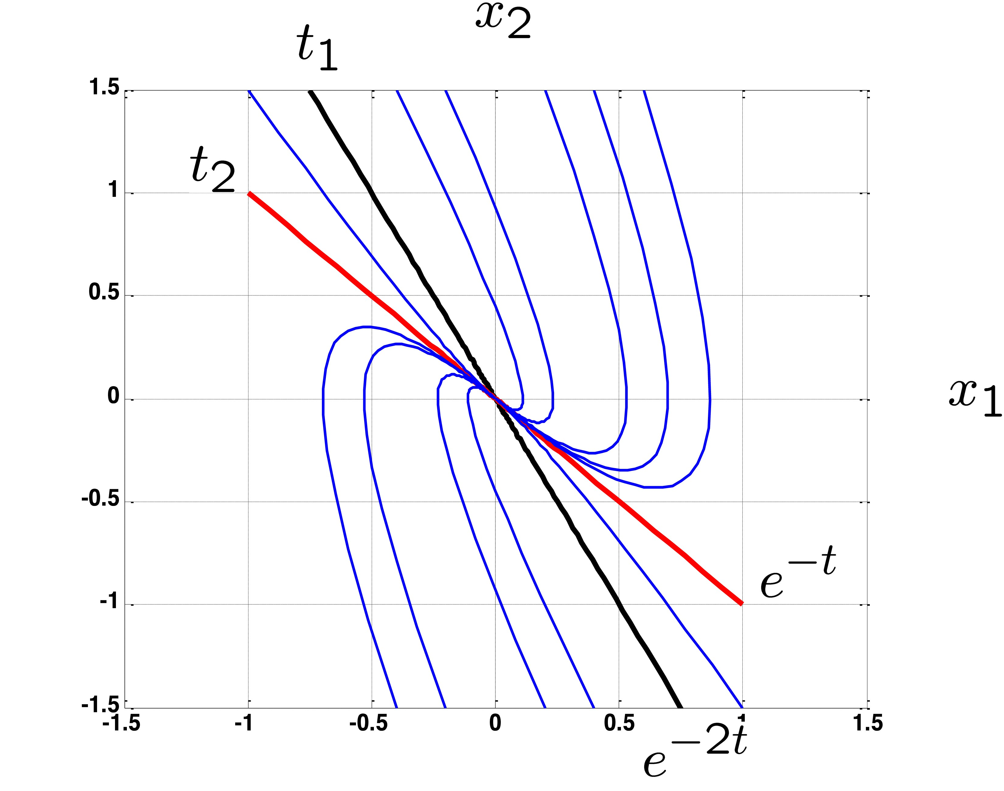
Similarity transform: diagonalization
Physical interpretations
t 1
x
2
a2e^{-t}t2
t ₂
x(0)
_{a1e}-2t_{t1}
x₁
State-Space Solution

Slide 56

Similarity transformation
The case with complex eigenvalues
consider the undamped spring-mass system
$$\frac{d}{dt}\left[\begin{matrix}x_{1} \\ x_{2}\end{matrix}\right]=\underset{A}{\underset{⏟}{\left[\begin{matrix}0 & 1 \\ −1 & 0\end{matrix}\right]}}\left[\begin{matrix}x_{1} \\ x_{2}\end{matrix}\right], det\left(A−λI\right)=λ^{2}+1=0⇒λ_{1,2,}=±j.$$
the eigenvectors are
$λ_{1}=j: \left(A−jI\right)t_{1}=0⇒t_{1}=\left[\begin{matrix}1 \\ j\end{matrix}\right]$
$λ_{2}=−j: \left(A+jI\right)t_{2}=0⇒t_{2}=\left[\begin{matrix}1 \\ −j\end{matrix}\right]$ (complex conjugate of $t_{1}$)
hence
$$\begin{matrix}T & =\left[\begin{matrix}1 & 1 \\ j & −j\end{matrix}\right], T^{−1}=\frac{1}{2}\left[\begin{matrix}1 & −j \\ 1 & j\end{matrix}\right]\end{matrix}$$
State-Space Solution

Slide 57

Similarity transformation
The case with complex eigenvalues
$$\frac{d}{dt}\left[\begin{matrix}x_{1} \\ x_{2}\end{matrix}\right]=\underset{A}{\underset{⏟}{\left[\begin{matrix}0 & 1 \\ −1 & 0\end{matrix}\right]}}\left[\begin{matrix}x_{1} \\ x_{2}\end{matrix}\right]$$
$λ_{1,2,}=±j$
$$T=\left[\begin{matrix}1 & 1 \\ j & −j\end{matrix}\right], T^{−1}=\frac{1}{2}\left[\begin{matrix}1 & −j \\ 1 & j\end{matrix}\right]$$
we have
$$e^{At}=Te^{Λt}T^{−1}=T\left[\begin{matrix}e^{jt} & 0 \\ 0 & e^{−jt}\end{matrix}\right]T^{−1}=\left[\begin{matrix}cost & sint \\ −sint & cost\end{matrix}\right]$$
State-Space Solution

Slide 58

Similarity transformation
The case with complex eigenvalues
for a general $A∈ℝ^{2×2}$ with complex eigenvalues σ ± jω, by using
T = [t_{R}, t_{I}], where t_{R} and t_{I} are the real and the imaginary parts of t₁, an eigenvector associated with λ₁ = σ + jω , x = Tx∗ transforms x˙ = Ax to
$${\dot{x}}^{∗}\left(t\right)=\left[\begin{matrix}σ & ω \\ −ω & σ\end{matrix}\right]x^{∗}\left(t\right)$$
and
$$e^{\left[\begin{matrix}σ & ω \\ −ω & σ\end{matrix}\right]t}=\left[\begin{matrix}e^{σt}cosωt & e^{σt}sinωt \\ −e^{σt}sinωt & e^{σt}cosωt\end{matrix}\right]$$
State-Space Solution

Slide 59

Similarity transformation
The case with repeated eigenvalues via generalized eigenvectors
consider $A=\left[\begin{matrix}1 & 2 \\ 0 & 1\end{matrix}\right]$: two repeated eigenvalues $λ\left(A\right)=1$, and
$$\left(A−λI\right)t_{1}=\left[\begin{matrix}0 & 2 \\ 0 & 0\end{matrix}\right]t_{1}=0⇒t_{1}=\left[\begin{matrix}1 \\ 0\end{matrix}\right]$$
No other linearly independent eigenvectors exist. What next?
$A$ is already very similar to the Jordan form. Try instead
$$A\left[\begin{matrix}t_{1} & t_{2}\end{matrix}\right]=\left[\begin{matrix}t_{1} & t_{2}\end{matrix}\right]\left[\begin{matrix}λ & 1 \\ 0 & λ\end{matrix}\right]$$
which requires $At_{2}=t_{1}+λt_{2}$, i.e.,
$$\left(A−λI\right)t_{2}=t_{1}⇔\left[\begin{matrix}0 & 2 \\ 0 & 0\end{matrix}\right]t_{2}=\left[\begin{matrix}1 \\ 0\end{matrix}\right]⇒t_{2}=\left[\begin{matrix}0 \\ 0.5\end{matrix}\right]$$
$t_{2}$ is linearly independent from $t_{1}$ $⇒$ $t_{1}$ and $t_{2}$ span $ℝ^{2}$. ($t_{2}$ is called a generalized eigenvector.)
State-Space Solution

Slide 60

Similarity transformation
The case with repeated eigenvalues via generalized eigenvectors
for general 3 × 3 matrices with det(λI − A) = (λ − λ_{m})³, i.e.,
λ₁ = λ₂ = λ₃ = λ_{m}, we look for T such that
A = TJT⁻¹
where J has three canonical forms:
$$\begin{matrix}i), \left[\begin{matrix}λ_{m} & 0 & 0 \\ 0 & λ_{m} & 0 \\ 0 & 0 & λ_{m}\end{matrix}\right], iii), \left[\begin{matrix}λ_{m} & 1 & 0 \\ 0 & λ_{m} & 1 \\ 0 & 0 & λ_{m}\end{matrix}\right] \\ ii), \left[\begin{matrix}λ_{m} & 1 & 0 \\ 0 & λ_{m} & 0 \\ 0 & 0 & λ_{m}\end{matrix}\right] \text{or} \left[\begin{matrix}λ_{m} & 0 & 0 \\ 0 & λ_{m} & 1 \\ 0 & 0 & λ_{m}\end{matrix}\right]\end{matrix}$$
State-Space Solution

Slide 61

Similarity transformation
The case with repeated eigenvalues via generalized eigenvectors
i), A = TJT , J = $\left[\begin{matrix}λ_{m} & 0 & 0 \\ 0 & λ_{m} & 0 \\ 0 & 0 & λ_{m}\end{matrix}\right]$
−1
this happens
when A has three linearly independent eigenvectors, i.e.,
(A − λ_{m}I)t = 0 yields t₁, t₂, and t₃ that span R³
mathematically: when nullity (A − λ_{m}I) = 3, namely, rank(A − λ_{m}I) = 3 − nullity (A − λ_{m}I) = 0
State-Space Solution

Slide 62


Similarity transformation
The case with repeated eigenvalues via generalized eigenvectors
ii), A = TJT , J = $\left[\begin{matrix}λ_{m} & 1 & 0 \\ 0 & λ_{m} & 0 \\ 0 & 0 & λ_{m}\end{matrix}\right] \text{or} \left[\begin{matrix}λ_{m} & 0 & 0 \\ 0 & λ_{m} & 1 \\ 0 & 0 & λ_{m}\end{matrix}\right]$
−1
this happens when (A − λ_{m}I)t = 0 yields two linearly independent solutions, i.e., when nullity (A − λ_{m}I) = 2
we then have, e.g.,
$$\left[\begin{matrix}λ_{m} & 1 & 0 \\ 0 & λ_{m} & 0 \\ 0 & 0 & λ_{m}\end{matrix}\right]$$
A[t₁, t₂, t₃] = [t₁, t₂, t₃]
⇔ [λ_{m}t₁, t₁ + λ_{m}t₂, λ_{m}t₃] = [At₁, At₂, At₃]
t₁ and t₃ are the directly computed eigenvectors
for t₂, the second column of the above gives (A − λ_{m}I) t₂ = t₁
State-Space Solution

Slide 63


Similarity transformation
The case with repeated eigenvalues via generalized eigenvectors
iii), A = TJT , J = $\left[\begin{matrix}λ_{m} & 1 & 0 \\ 0 & λ_{m} & 1 \\ 0 & 0 & λ_{m}\end{matrix}\right]$
this is for the case when (A − λ_{m}I)t = 0 yields only one linearly independent solution, i.e., when nullity(A − λ_{m}I) = 1
We then have
$$\left[\begin{matrix}λ_{m} & 1 & 0 \\ 0 & λ_{m} & 1 \\ 0 & 0 & λ_{m}\end{matrix}\right]$$
A[t₁, t₂, t₃] = [t₁, t₂, t₃]
⇔ [λ_{m}t₁, t₁ + λ_{m}t₂, t₂ + λ_{m}t₃] = [At₁, At₂, At₃]
yielding
(A − λ_{m}I) t₁ = 0
(A − λ_{m}I) t₂ = t₁, (t₂ : generalized eigenvector)
State-Space Solution

Slide 64

Example
$$A=\left[\begin{matrix}−1 & 1 \\ −1 & 1\end{matrix}\right], det\left(A−λI\right)=λ^{2}⇒λ_{1}=λ_{2}=0, J=\left[\begin{matrix}0 & 1 \\ 0 & 0\end{matrix}\right]$$
two repeated eigenvalues with $\text{rank}\left(A−0I\right)=1⇒$ only one linearly independent eigenvector:$\left(A−0I\right)t_{1}=0⇒t_{1}=\left[\begin{matrix}1 \\ 1\end{matrix}\right]$
generalized eigenvector:$\left(A−0I\right)t_{2}=t_{1}⇒t_{2}=\left[\begin{matrix}0 \\ 1\end{matrix}\right]$
coordinate transform matrix:
$$T=\left[t_{1},t_{2}\right]=\left[\begin{matrix}1 & 0 \\ 1 & 1\end{matrix}\right], T^{−1}=\left[\begin{matrix}1 & 0 \\ −1 & 1\end{matrix}\right]$$
$$e^{At}=Te^{Jt}T^{−1}=\left[\begin{matrix}1 & 0 \\ 1 & 1\end{matrix}\right]\left[\begin{matrix}e^{0t} & te^{0t} \\ 0 & e^{0t}\end{matrix}\right]\left[\begin{matrix}1 & 0 \\ −1 & 1\end{matrix}\right]=\left[\begin{matrix}1−t & t \\ −t & 1+t\end{matrix}\right]$$
State-Space Solution

Slide 65

Example
$$A=\left[\begin{matrix}−1 & 1 \\ −1 & 1\end{matrix}\right], det\left(A−λI\right)=λ^{2}⇒λ_{1}=λ_{2}=0.$$
observation:
$λ_{1}=0$, $t_{1}=\left[\begin{matrix}1 \\ 1\end{matrix}\right]$ implies that if $x_{1}\left(0\right)=x_{2}\left(0\right)$ then the response is characterized by $e^{0t}=1$
i.e., $x_{1}\left(t\right)=x_{1}\left(0\right)=x_{2}\left(0\right)=x_{2}\left(t\right)$. This makes sense because ${\dot{x}}_{1}=−x_{1}+x_{2}$ from the state equation
State-Space Solution

Slide 66

Exercise
Obtain the eigenvectors of
$$A=\left[\begin{matrix}−2 & 2 & −3 \\ 2 & 1 & −6 \\ −1 & −2 & 0\end{matrix}\right] \left(λ_{1}=5, λ_{2}=λ_{3}=−3\right).$$
State-Space Solution

Slide 67


Generalized eigenvectors
Physical interpretation
when $\dot{x}=Ax$, $A=TJT^{−1}$ with $J=\left[\begin{matrix}λ_{m} & 1 & 0 \\ 0 & λ_{m} & 0 \\ 0 & 0 & λ_{m}\end{matrix}\right]$, we have
$$x\left(t\right)=e^{At}x\left(0\right)=T\left[\begin{matrix}e^{λ_{m}t} & te^{λ_{m}t} & 0 \\ 0 & e^{λ_{m}t} & 0 \\ 0 & 0 & e^{λ_{m}t}\end{matrix}\right]T^{−1}x\left(0\right)=T\left[\begin{matrix}e^{λ_{m}t} & te^{λ_{m}t} & 0 \\ 0 & e^{λ_{m}t} & 0 \\ 0 & 0 & e^{λ_{m}t}\end{matrix}\right]T^{−1}Tx^{∗}\left(0\right)$$
if the initial condition is in the direction of $t_{1}$, i.e., $x^{∗}\left(0\right)={\left[x_{1}^{∗}\left(0\right),0, 0\right]}^{T}$ and $x_{1}^{∗}\left(0\right)≠0$, the above equation yields $x\left(t\right)=x_{1}^{∗}\left(0\right)t_{1}e^{λ_{m}t}$
$$I$$
State-Space Solution

Slide 68

Generalized eigenvectors
Physical interpretation
when $\dot{x}=Ax$, $A=TJT^{−1}$ with $J=\left[\begin{matrix}λ_{m} & 1 & 0 \\ 0 & λ_{m} & 0 \\ 0 & 0 & λ_{m}\end{matrix}\right]$, we have
$$x\left(t\right)=e^{At}x\left(0\right)=T\left[\begin{matrix}e^{λ_{m}t} & te^{λ_{m}t} & 0 \\ 0 & e^{λ_{m}t} & 0 \\ 0 & 0 & e^{λ_{m}t}\end{matrix}\right]T^{−1}x\left(0\right)=T\left[\begin{matrix}e^{λ_{m}t} & te^{λ_{m}t} & 0 \\ 0 & e^{λ_{m}t} & 0 \\ 0 & 0 & e^{λ_{m}t}\end{matrix}\right]T^{−1}Tx^{∗}\left(0\right)$$
if $x\left(0\right)$ starts in the direction of $t_{2}$, i.e., $x^{∗}\left(0\right)={\left[0,x_{2}^{∗}\left(0\right),0\right]}^{T}$, then $x\left(t\right)=x_{2}^{∗}\left(0\right)\left(t_{1}te^{λ_{m}t}+t_{2}e^{λ_{m}t}\right)$. In this case, the response does not remain in the direction of $t_{2}$ but is confined in the subspace spanned by $t_{1}$ and $t_{2}$
$$I$$
State-Space Solution

Slide 69

Example
Obtain eigenvalues of $J$ and $e^{Jt}$ by inspection:
$$J=\left[\begin{matrix}−1 & 0 & 0 & 0 & 0 \\ 0 & −2 & 1 & 0 & 0 \\ 0 & −1 & −2 & 0 & 0 \\ 0 & 0 & 0 & −3 & 1 \\ 0 & 0 & 0 & 0 & −3\end{matrix}\right].$$
State-Space Solution

Slide 70

1 Introduction
2
Continuous-time state-space solution
3
Discrete-time state-space solution
4
Explicit computation of the state transition matrix e^{At}
5
Explicit Computation of the State Transition Matrix A^{k}
6 Transition Matrix via Inverse Transformation
State-Space Solution

Slide 71

Explicit computation of A^{k}
everything in getting the similarity transform applies to the DT case:
A^{k} = TΛ^{k}T⁻¹ or A^{k} = TJ^{k}T⁻¹
$$J$$ | $$J_{k}$$
$$\left[\begin{matrix}λ_{1} & 0 \\ 0 & λ_{2}\end{matrix}\right]$$ | $$\left[\begin{matrix}λ_{1}^{k} & 0 \\ 0 & λ_{2}^{k}\end{matrix}\right]$$
$$\left[\begin{matrix}λ & 1 & 0 \\ 0 & λ & 1 \\ 0 & 0 & λ\end{matrix}\right]$$ | $$\left[\begin{matrix}λ^{k} & kλ^{k−1} & \frac{1}{2!}k\left(k−1\right)λ^{k−2} \\ 0 & λ^{k} & kλ^{k−1} \\ 0 & 0 & λ^{k}\end{matrix}\right]$$
$$\left[\begin{matrix}λ & 1 & 0 \\ 0 & λ & 0 \\ 0 & 0 & λ_{3}\end{matrix}\right]$$ | $$\left[\begin{matrix}λ^{k} & kλ^{k−1} & 0 \\ 0 & λ^{k} & 0 \\ 0 & 0 & λ_{3}^{k}\end{matrix}\right]$$
$$\left[\begin{matrix}σ & ω \\ −ω & σ\end{matrix}\right]$$ | $$r^{k}\left[\begin{matrix}\cos{kθ} & \sin{kθ} \\ −\sin{kθ} & \cos{kθ}\end{matrix}\right]$$ $$r=\sqrt{σ^{2}+ω^{2}}$$ $$θ=\tan^{−1}{\frac{ω}{σ}}$$
State-Space Solution

Slide 72

Example
Write down $J^{k}$ for $J=\left[\begin{matrix}−1 & 0 & 0 \\ 0 & −1 & 1 \\ 0 & 0 & −1\end{matrix}\right]$ and $J=\left[\begin{matrix}−10 & 1 & 0 & 0 & 0 \\ 0 & −10 & 0 & 0 & 0 \\ 0 & 0 & −2 & 0 & 0 \\ 0 & 0 & 0 & −100 & 1 \\ 0 & 0 & 0 & −1 & −100\end{matrix}\right]$.
State-Space Solution

Slide 73

1 Introduction
2
Continuous-time state-space solution
3
Discrete-time state-space solution
4
Explicit computation of the state transition matrix e^{At}
5
Explicit Computation of the State Transition Matrix A^{k}
6 Transition Matrix via Inverse Transformation
State-Space Solution

Slide 74


Transition matrix via inverse transformation
 | Continuous-time system
state eq. | x˙(t) = Ax(t) + Bu(t), x(0) = x₀
solution | $$x\left(t\right)=\underset{\text{free} \text{response}}{\underset{⏟}{e^{At}x\left(0\right)}}+\underset{\text{forced} \text{response}}{\underset{⏟}{\int_{0}^{t}{e^{A\left(t−τ\right)}}Bu\left(τ\right)dτ}}$$
transition matrix | $$e^{At}$$
On the other hand, from Laplace transform:
$$\dot{x}\left(t\right)=Ax\left(t\right)+Bu\left(t\right)⇒X\left(s\right)=\underset{\text{free} \text{response}}{\underset{⏟}{{\left(sI−A\right)}^{−1}x\left(0\right)}}+\underset{\text{forced} \text{response}}{\underset{⏟}{{\left(sI−A\right)}^{−1}BU\left(s\right)}}$$
Comparing $x\left(t\right)$ and $X\left(s\right)$ gives
$$\boxed{e^{At}=ℒ^{−1}\left\{{\left(sI−A\right)}^{−1}\right\}}$$
State-Space Solution

Slide 75

Example
$$A=\left[\begin{matrix}σ & ω \\ −ω & σ\end{matrix}\right]$$
$$\begin{matrix}e^{At} & =ℒ^{−1}{\left[\begin{matrix}s−σ & −ω \\ ω & s−σ\end{matrix}\right]}^{−1} \\ & =ℒ^{−1}\left\{\frac{1}{{\left(s−σ\right)}^{2}+ω^{2}}\left[\begin{matrix}s−σ & ω \\ −ω & s−σ\end{matrix}\right]\right\} \\ & =e^{σt}\left[\begin{matrix}cos\left(ωt\right) & sin\left(ωt\right) \\ −sin\left(ωt\right) & cos\left(ωt\right)\end{matrix}\right]\end{matrix}$$
State-Space Solution

Slide 76


Transition matrix via inverse transformation (DT case)
 | Discrete-time system
state eq. | x(k + 1) = Ax(k) + Bu(k), x(0) = x₀
solution | $$x\left(k\right)=\underset{\text{free} \text{response}}{\underset{⏟}{A^{k}x\left(0\right)}}+\underset{\text{forced} \text{response}}{\underset{⏟}{\sum_{j=0}^{\left(k−1\right)}{A^{\left(k−1−j\right)}Bu\left(j\right)}}}$$
transition matrix | $$A^{k}$$
On the other hand, from Z transform:
$$X\left(z\right)={\left(zI−A\right)}^{−1}zx\left(0\right)+{\left(zI−A\right)}^{−1}BU\left(s\right)$$
Hence
$$\boxed{A^{k}=𝒵^{−1}\left\{{\left(zI−A\right)}^{−1}z\right\}}$$
State-Space Solution

Slide 77

Example
$$A=\left[\begin{matrix}σ & ω \\ −ω & σ\end{matrix}\right]$$
$$\begin{matrix}A^{k} & =𝒵^{−1}\left\{z{\left[\begin{matrix}z−σ & −ω \\ ω & z−σ\end{matrix}\right]}^{−1}\right\} \\ & =𝒵^{−1}\left\{\frac{z}{{\left(z−σ\right)}^{2}+ω^{2}}\left[\begin{matrix}z−σ & ω \\ −ω & z−σ\end{matrix}\right]\right\} \\ & =𝒵^{−1}\left\{\frac{z}{z^{2}−2rcosθz+r^{2}}\left[\begin{matrix}z−rcosθ & rsinθ \\ −rsinθ & z−rcosθ\end{matrix}\right]\right\} \\ & , r=\sqrt{σ^{2}+ω^{2}}, θ=\tan^{−1}\frac{ω}{σ} \\ & =r^{k}\left[\begin{matrix}coskθ & sinkθ \\ −sinkθ & coskθ\end{matrix}\right]\end{matrix}$$
State-Space Solution

Slide 78

Example
Consider $A=\left[\begin{matrix}0.7 & 0.3 \\ 0.1 & 0.5\end{matrix}\right]$. We have
$$\begin{matrix} & {\left(zI−A\right)}^{−1}z \\ = & \left[\begin{matrix}\frac{z\left(z−0.5\right)}{\left(z−0.8\right)\left(z−0.4\right)} & \frac{0.3z}{\left(z−0.8\right)\left(z−0.4\right)} \\ \frac{0.1z}{\left(z−0.8\right)\left(z−0.4\right)} & \frac{z\left(z−0.7\right)}{\left(z−0.8\right)\left(z−0.4\right)}\end{matrix}\right] \\ = & \left[\begin{matrix}\frac{0.75z}{z−0.8}+\frac{0.25z}{z−0.4} & \frac{0.75z}{z−0.8}−\frac{0.75z}{z−0.4} \\ \frac{0.25z}{z−0.8}−\frac{0.25z}{z−0.4} & \frac{0.25z}{z−0.8}+\frac{0.75z}{z−0.4}\end{matrix}\right] \\ ⇒A^{k}= & \left[\begin{matrix}0.75{\left(0.8\right)}^{k}+0.25{\left(0.4\right)}^{k} & 0.75{\left(0.8\right)}^{k}−0.75{\left(0.4\right)}^{k} \\ 0.25{\left(0.8\right)}^{k}−0.25{\left(0.4\right)}^{k} & 0.25{\left(0.8\right)}^{k}+0.75{\left(0.4\right)}^{k}\end{matrix}\right]\end{matrix}$$
State-Space Solution

